Slide 1
Class Agenda
Principal Components Analysis Example using Linear Regression Example from Last Class’ Lab
Model Evaluation
  We saw Prediction Evaluation previously
  Today we will see Classification Model Evaluation
    Model Comparison Node for Classification Model Evaluation

Slide 2
Dimensionality Reduction: Principal Component Analysis Node (PCA) (pp. 102-103 in text book)
Principal Components Node in EMiner
Given N data vectors from n-dimensions, find k ≤ n orthogonal vectors (principal components) that can be best used to represent data
Steps
  Normalize input data: Each attribute falls within the same range
  Compute k orthonormal (unit) vectors, i.e., principal components
  Each input data (vector) is a linear combination of the k principal component vectors
  The principal components are sorted in order of decreasing “significance” or strength
  Since the components are sorted, the size of the data can be reduced by eliminating the weak components, i.e., those with low variance. (i.e., using the strongest principal components, it is possible to reconstruct a good approximation of the original data
Works for numeric data only
Used when the number of dimensions is large

Slide 3
Principal Components Node Example
We have a high-level definition of PCA
Now, we will see how to run a PCA in Enterprise Miner to handle the multicollinearity present in the predictors of height from our linear regression lab.
In PCA, the factors are ordered in the order in which they explain more dependent (target) variable variance
  It may be possible to drop some of the less important factors as they may not add much to model quality – Use model evaluation techniques we will discuss to decide this

Slide 4
MODEL EVALUATION – SECTION 8.5 IN BOOK

Slide 5
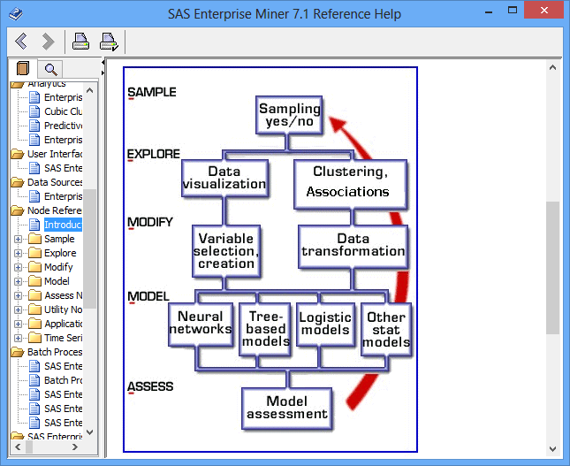
SEMMA Process
Source: SAS Enterprise Miner help

Slide 6
Classification vs. Prediction
Classification
  predicts categorical class labels (discrete or nominal)
  classifies data (constructs a model) based on the training set and the values (class labels) in a classifying attribute and uses it in classifying new data
Prediction
  models continuous-valued functions, i.e., predicts unknown or missing values
Typical applications
  Credit approval
  Target marketing
  Medical diagnosis
  Fraud detection

Slide 7
Classifier Accuracy Measures –
Model Comparison Node
 | C₁ | C₂
C₁ | True positive | False negative
C₂ | False positive | True negative
classes | buy_computer = yes | buy_computer = no | total | recognition(%)
buy_computer = yes | 6954 | 46 | 7000 | 99.34
buy_computer = no | 412 | 2588 | 3000 | 86.27
total | 7366 | 2634 | 10000 | 95.42
Accuracy of a classifier M, acc(M): percentage of test set tuples that are correctly classified by the model M
  Error rate (misclassification rate) of M = 1 – acc(M)
  Given m classes, CM_{i,j}, an entry in a coincidence (confusion in the book) matrix, indicates # of tuples in class i that are labeled by the classifier as class j
Alternative accuracy measures (e.g., for cancer diagnosis)
  sensitivity = t-pos/pos /* true positive recognition rate */
  specificity = t-neg/neg /* true negative recognition rate */
  precision = t-pos/(t-pos + f-pos)
  accuracy = sensitivity * pos/(pos + neg) + specificity * neg/(pos + neg)
  This model can also be used for cost-benefit analysis

Slide 8

Model Selection: ROC Curves –Model Comparison Node
ROC (Receiver Operating Characteristics) curves: for visual comparison of classification models
Originated from signal detection theory
Shows the trade-off between the true positive rate and the false positive rate
The area under the ROC curve is a measure of the accuracy of the model
Rank the test tuples in decreasing order: the one that is most likely to belong to the positive class appears at the top of the list
The closer to the diagonal line (i.e., the closer the area is to 0.5), the less accurate is the model
Vertical axis represents the true positive rate
Horizontal axis rep. the false positive rate
The plot also shows a diagonal line
A model with perfect accuracy will have an area of 1.0

Slide 9
Model Comparison Node
The Model Comparison node belongs to the Assess category in the SAS data mining process of Sample, Explore, Modify, Model, and Assess (SEMMA). The Model Comparison node enables you to compare the performance of competing models using various benchmarking criteria.
There are many criteria that can be used to compare models. Comparing model performance depends on the specific application for the model. For example, with binary targets the Model Comparison node provides criteria that are derived from several sources.
Classification Measures: comparative criteria include the Receiver Operating Characteristic (ROC) charts and corresponding area under the curve, classification rates, and so on.
Data Mining Measures: comparative criteria from the study of data mining include lift and gain measures and profit and loss measures.
Statistical Measures: comparative criteria from statistical literature include Bayesian Information Criterion (BIC), Akaike's Information Criterion (AIC), Gini statistics, Kolmogorov-Smirnov statistics, and Bin-Best Two-Way Kolmogorov-Smirnov tests.
The combined criteria enable the analyst to make cross-model comparisons and assessments.
When you train a modeling node, assessment statistics are computed on the train (and validation) data sets. The Model Comparison node computes the same statistics for the test set when it is present. SOURCE: Eminer Help

Slide 10
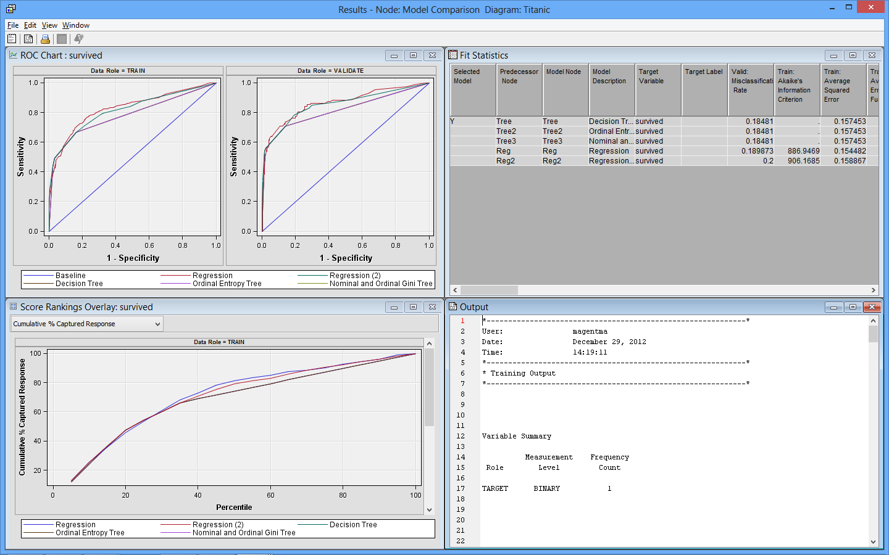
Model Comparision Node Results

Slide 11
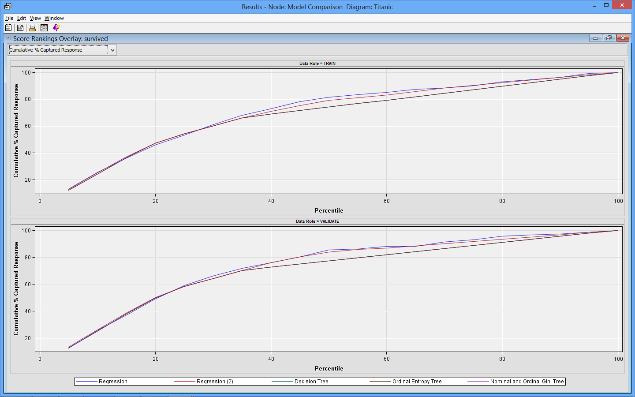
Model Selection – Cumulative % Captured Chart (Model Comparison Node)
Hit % Captured are defined as the proportion of total hits that occurs in each quantile. Gains are computed as (number of hits in quantile / total number of hits) × 100%.

Slide 12
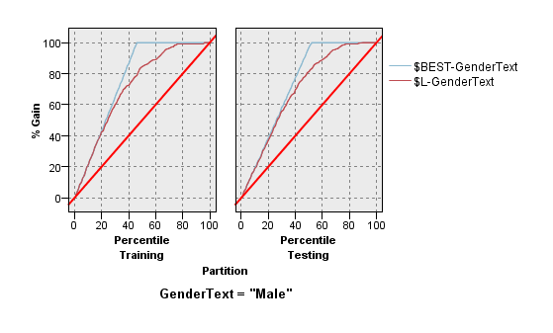
Cumulative % Captured Chart Interpretation (Image from IBM Modeler)
Best line is the light blue line. This line represents the best gain possible if you ordered all hits before any misses.
Baseline is the red line. This line represents selecting at random. In other words, if you randomly selected 30% of the data, you would expect to get 30% of the hits.
The brown line represents the model. It is better if this line is as close to the best line as possible
Rank the test tuples in decreasing order
Interpretation of the Testing Set Cumulative % Captured Chart @ 40% sample: By using the model, we can identify 69.535% of the males. The best we can do is 77.519% males and the baseline is 40% males.

Slide 13
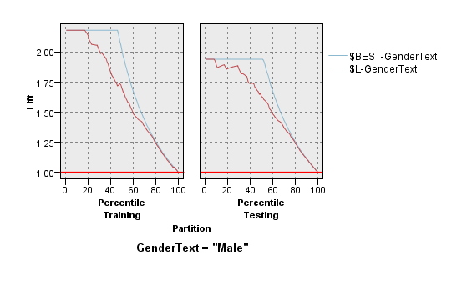
Cumulative Lift Chart (Image from IBM Modeler)
This is the cumulative lift chart corresponding to the Cumulative % Captured Chart on previous slide.
The best lift is the light blue line, the baseline is the red, and the model the brown line.
Baseline lift is defined as 1.
The best lift for the Testing Set is 1.938. This is because there are 51.6% males in the testing set and 1/.516 = 1.938
Lift can be derived from Cumulative % Captured
Lift is the multiple of improvement of the model hit rate over the baseline hit rate.
In our previous gains chart, at 40% sample we saw a 69.5% male hit rate with the model. This means the lift of the model over the baseline is 69.535/40 = 1.738

Slide 14
In this lecture, we saw quantitative measures for evaluating models – what role do qualitative issues play?
Things to consider
  Simple Models are Better Models all else being equal
  People Issues
    Model complexity may make explaining model difficult (e.g. Principal Components)
    Are there people on the project who have pre-determined opinions? May need to take this into account in determining which model is best
  Ethical Issues
  Other qualitative issues…

